Slide 1
Git By Example

Slide 2
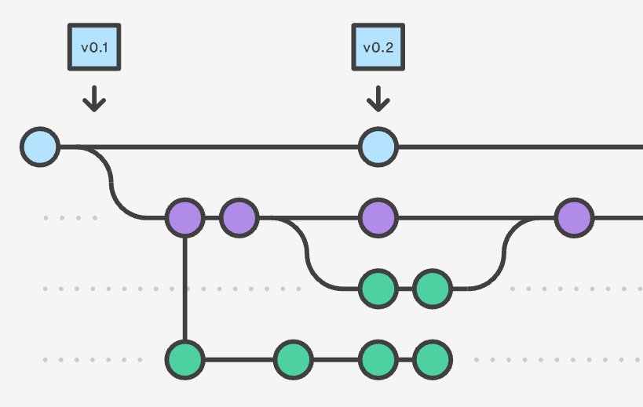
What is Git?
Version control system
Repository
Notes:
(CLICK) Git is a version control system which keeps track of changes made to software and by whom those changes were made by. This is going to help manage changes to source code over time
(CLICK) Git is able to track these changes through a repository. This is where your files and versions are stored. This can be stored locally or in the cloud.

Slide 3
What is Git?
Version control system
Repository
Notes:
(CLICK) Git is a version control system which keeps track of changes made to software and by whom those changes were made by. This is going to help manage changes to source code over time
(CLICK) Git is able to track these changes through a repository. This is where your files and versions are stored. This can be stored locally or in the cloud.

